Slide 1
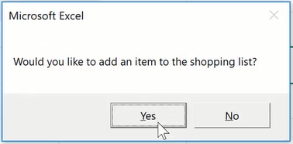
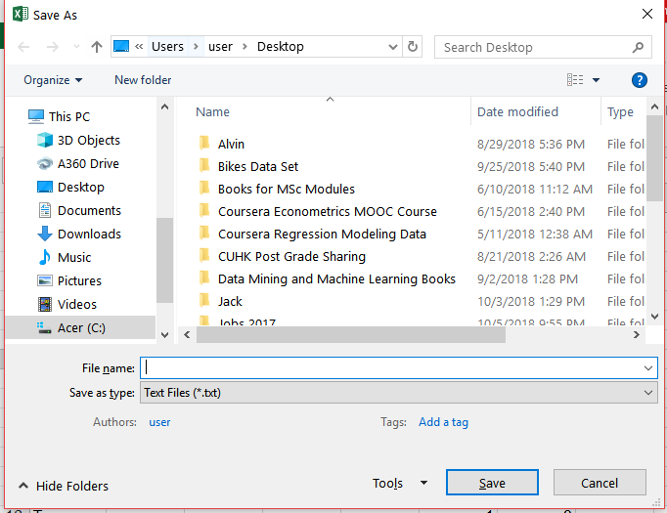
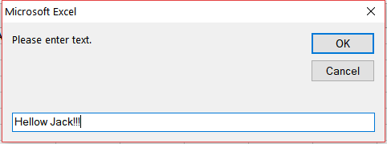
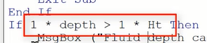
Useful Quick Codes
Find gradient and intercept
m = WorksheetFunction.Slope(y, x)
b = WorksheetFunction.Intercept(y, x)
Yes No Button in Message Box (vbYesNo)
Do
Ans = MsgBox("Would you like to add another item to the list?", vbYesNo)
If Ans = 7 Then Exit Do
i = i + 1
ReDim Preserve L(i) As Variant
L(i) = InputBox("Enter New Item:")
6 = Yes, 7 = No
Create a .txt file and write data to it
Dim SaveFile as string
'SaveFile is the file name user input into the save file window
SaveFile = Application.GetSaveAsFilename(filefilter:="Text Files (*.txt), *.txt")
'We open that file which at the moment is empty
Open SaveFile For Output As #1
'we write s to that empty file, then close the file
Write #1, s
Close #1
Create a .txt file and write data to it
Convert a string into a number by multiplying by 1

Slide 2
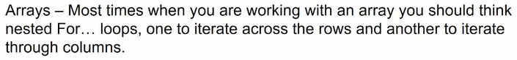
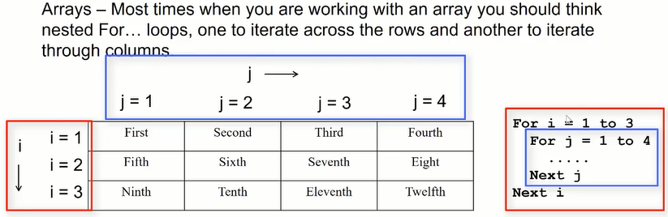
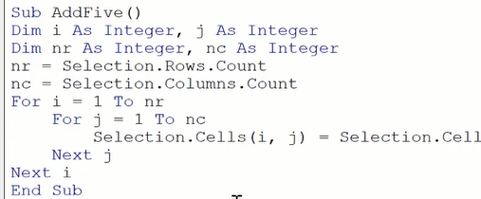
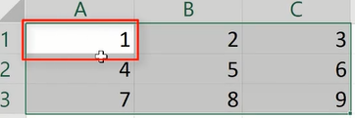
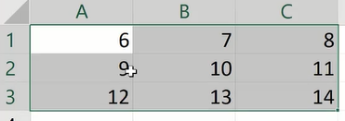
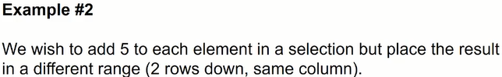
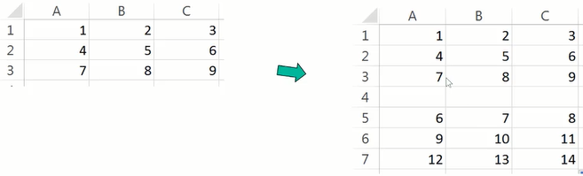
Coursera Excel/VBA – Part 2
Sub AddFive()
Dim i As Integer, j As Integer
Dim nr As Integer, nc As Integer
nr = Selection.Rows.Count
nc = Slection.Columns.Count
For i = 1 To nr
For j = 1 To nc
ActiveCell.Offest(nr + i, j - 1) = Selection.Cells(i, j)
Next j
Next i
End Sub

Slide 3
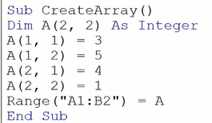
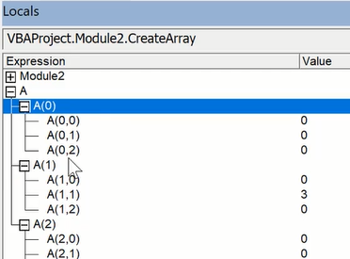
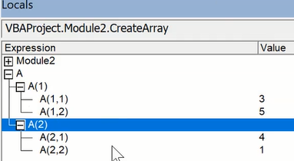
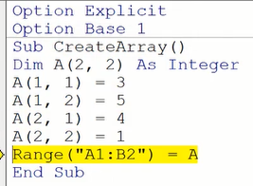
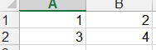
Create Local Arrays
Array A(2,2) includes a zeroth row, so it is actually a 3x3 array.
The local window will show what is inside the array
Insert “Option Base 1” will get rid of the zeroth row and column, as can be seen in the locals window.
Sub CreateArray2()
Dim A(2, 2) As Integer, i As Integer, j As Integer
For i = 1 To 2
For j = 1 To 2
A(i, j) = InputBox("Please enter elements" & i & "," & j)
Next j
Next i
Range("A1:B2") = A
End Sub

Slide 4
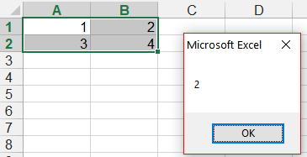
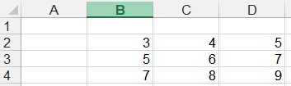
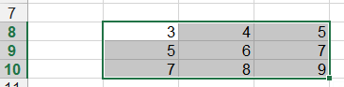
Import and Export Arrays into VBA
1) Import Excel array into VBA, the first is more cumbersome, the second is much simpler, and both does the same thing
Sub ImportArray1()
Dim i As Integer, j As Integer
Dim A() As Integer
Dim nr As Integer, nc As Integer
nr = Selection.Rows.Count
nc = Selection.Columns.Count
ReDim A(nr, nc) As Integer
For i = 1 To nr
For j = 1 To nc
A(i, j) = Selection.Cells(i, j)
Next j
Next i
MsgBox A(1, 2)
End Sub
Sub ImportArray2()
Dim A() As Variant
A = Selection
MsgBox A(1, 2)
End Sub
2) Export Array
Sub ExportArray1()
Dim i As Integer, j As Integer
Dim A(3, 3) As Integer
For i = 1 To 3
For j = 1 To 3
A(i, j) = 2 * i + j
Range("B2:D4").Cells(i, j) = A(i, j)
Next j
Next i
End Sub
Sub ExportArray2()
Dim i As Integer, j As Integer
Dim A(3, 3) As Integer
For i = 1 To 3
For j = 1 To 3
A(i, j) = 2 * i + j
Next j
Next i
Selection = A
End Sub

Slide 5
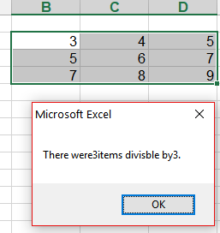
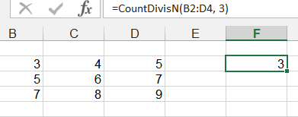
Using arrays in subroutines and functions
The Sub and Function below are doing the same thing. We are learning how to write the codes
Sub CountDivisibleByN()
Dim i As Integer, j As Integer, n As Integer, c As Integer
Dim nr As Integer, nc As Integer
nr = Selection.Rows.Count
nc = Selection.Columns.Count
n = InputBox("Enter the integer.")
For i = 1 To nr
For j = 1 To nc
If Selection.Cells(i, j) Mod n = 0 Then
c = c + 1
End If
Next j
Next i
MsgBox ("There were" & c & "items divisble by" & n & ".")
End Sub
Function
Option Base 1
Function CountDivisN(rng As Range, n As Integer) As Integer
Dim i As Integer, j As Integer, c As Integer
Dim nr As Integer, nc As Integer
nr = rng.Rows.Count
nc = rng.Columns.Count
For i = 1 To nr
For j = 1 To nc
If rng.Cells(i, j) Mod n = 0 Then
c = c + 1
End If
Next j
Next i
CountDivisN = c
End Function

Slide 6
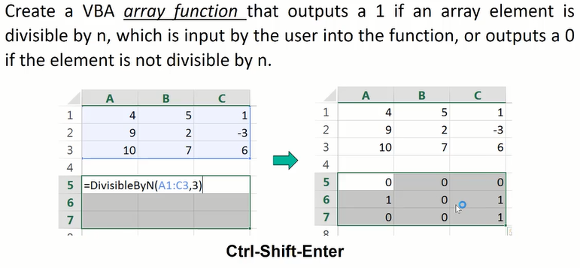
Create VBA Array Functions
Option Base 1
Function DivisbleByN(rng As Range, n As Integer) As Variant
Dim i As Integer, j As Integer
Dim nr As Integer, nc As Integer
Dim B() As Variant 'create a new array B without specifying size
nr = rng.Rows.Count
nc = rng.Columns.Count
ReDim B(nr, nc) As Variant
For i = 1 To nr
For j = 1 To nc
If rng.Cells(i, j) Mod n = 0 Then
B(i, j) = 1
End If ‘Don’t need Else B(i,j)=0 because it will treat empty cell as 0
Next j
Next i
DivisbleByN = B
End Function

Slide 7
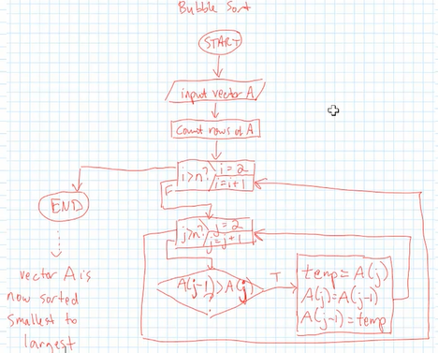
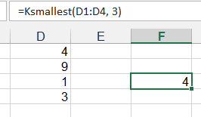
Create Bubble Sort Array Functions
Function SortVector(rng As Range)
Dim i As Integer, j As Integer, n As Integer
Dim Temp As Integer, A() As Variant
n = rng.Rows.Count
ReDim A(n, 1)
A = rng 'make a copy of rng and call it A
For i = 2 To n
For j = 2 To n
If A(j - 1, 1) > A(j, 1) Then
Temp = A(j, 1)
A(j, 1) = A(j - 1, 1)
A(j - 1, 1) = Temp
End If
Next j
Next i
SortVector = A
End Function
Create kth smallest element array function
Function Ksmallest(rng As Range, k As Integer)
Dim i As Integer, j As Integer, n As Integer
Dim Temp As Integer, A() As Variant
n = rng.Rows.Count
ReDim A(n, 1)
A = rng 'make a copy of rng and call it A
For i = 2 To n
For j = 2 To n
If A(j - 1, 1) > A(j, 1) Then
Temp = A(j, 1)
A(j, 1) = A(j - 1, 1)
A(j - 1, 1) = Temp
End If
Next j
Next i
Ksmallest = A(k, 1)
End Function

Slide 8
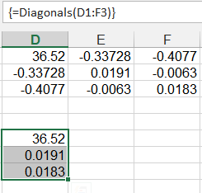
Extract diagonals of a covariance matrix
Options Base 1
Function Diagonals(rng As Range)
Dim i As Integer, n As Integer
Dim D()
n = rng.Rows.Count
'covariance matrix is square matrix so can count columns or rows
ReDim D(n, 1)
For i = 1 To n
D(i, 1) = rng.Cells(i, i)
Next i
Diagonals = D
End Function

Slide 9
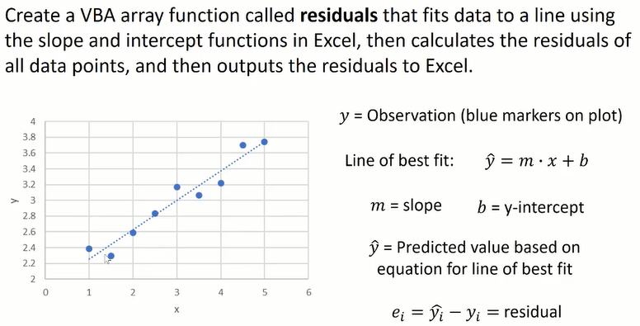
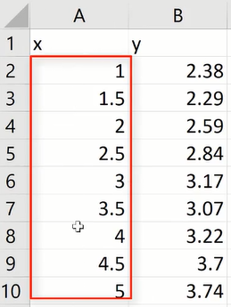
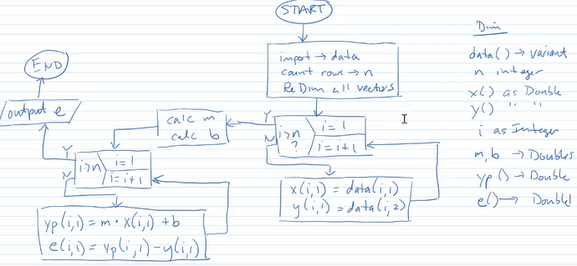
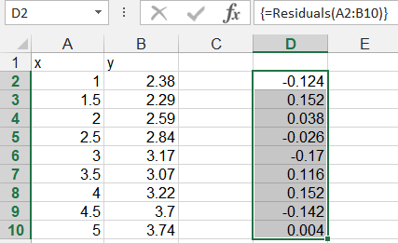
y_{p}
Function Residuals(rng As Range)
Dim i As Integer, n As Integer, Data()
Dim x() As Double, y() As Double, yp() As Double
Dim m As Double, b As Double, e() As Double
Data = rng
n = rng.Rows.Count
ReDim x(n, 1) As Double, y(n, 1) As Double
ReDim yp(n, 1) As Double, e(n, 1) As Double
'import data into VBA variables(x,y) using For loop
For i = 1 To n
x(i, 1) = Data(i, 1)
y(i, 1) = Data(i, 2)
Next i
'now calculate m and b for line of best fit
m = WorksheetFunction.Slope(y, x)
b = WorksheetFunction.Intercept(y, x)
'calculate the predicted y values (yp) and resideuals(e)
For i = 1 To n
yp(i, 1) = m * x(i, 1) + b
e(i, 1) = yp(i, 1) - y(i, 1)
Next i
Residuals = e
End Function

Slide 10
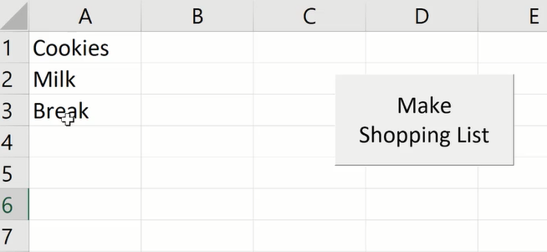
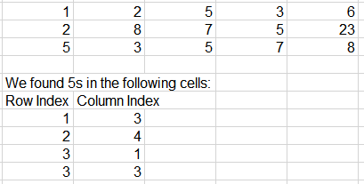
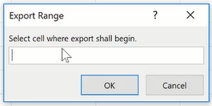
Preserve ReDim
As we insert items into the list, we have to resize the list, i.e. ReDim the vector, but have to preserve what is inside the vector as well.
Options Base 1
Sub ShoppingList()
Dim i As Integer, Ans As Integer, L() As Variant
Do
Ans = MsgBox("Would you like to add another item to the list?", vbYesNo)
If Ans = 7 Then Exit Do
i = i + 1
ReDim Preserve L(i) As Variant
L(i) = InputBox("Enter New Item:")
Loop
Range(“A1:A” & i) = WorksheetFunction.Transpose(L)
End Sub
‘we need transpose because default VBA vectors are row vectors
Sub FindFive()
Dim i As Integer, j As Integer, nr As Integer, nc As Integer
Dim rowmarker() As Integer, colmarker() As Integer, k As Integer
Dim UserRange As Range
nr = Selection.Rows.Count
nc = Selection.Columns.Count
For i = 1 To nr
For j = 1 To nc
If Selection.Cells(i, j) = 5 Then
k = k + 1
ReDim Preserve rowmarker(k) As Integer
ReDim Preserve colmarker(k) As Integer
rowmarker(k) = i
colmarker(k) = j
End If
Next j
Next i
If k <> 0 Then
MsgBox ("We found at least one 5!")
Set UserRange = Application.InputBox(Prompt:="Select cell where export shall begin.", _
Title:="Export Range", Type:=8)
UserRange.Select
ActiveCell = "We found 5s in the following cells:"
ActiveCell.Offset(1, 0) = "Row Index"
ActiveCell.Offset(1, 1) = "Column Index"
For i = 1 To k
ActiveCell.Offset(i + 1, 0) = rowmarker(i)
ActiveCell.Offset(i + 1, 1) = colmarker(i)
Next i
Else
MsgBox ("Sorry, no 5s were found")
End If
End Sub

Slide 11
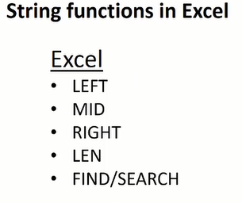
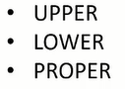
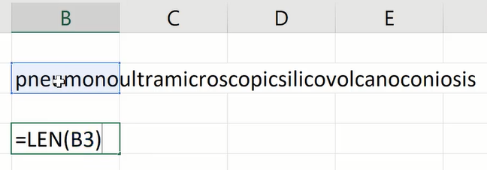
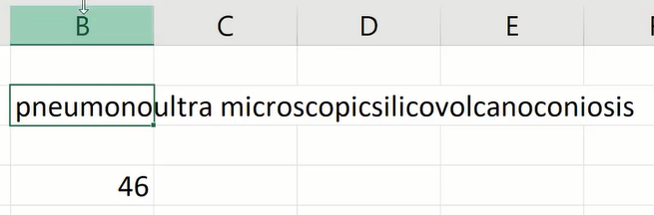
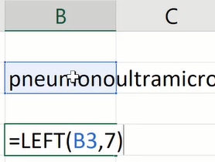
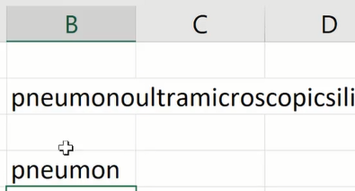
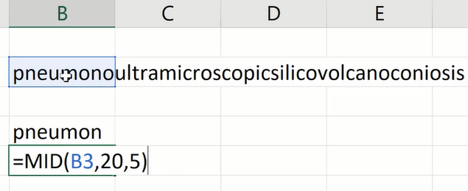
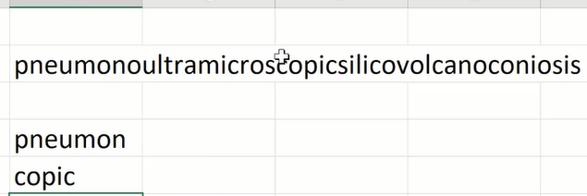
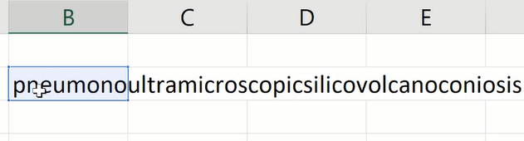
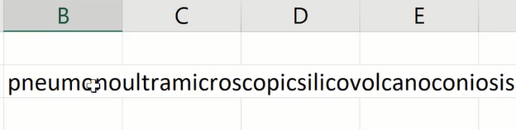
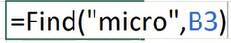
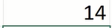
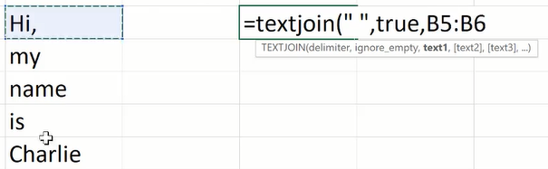
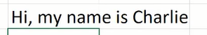
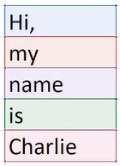
Working with Strings in Excel Worksheets
LEN(Cell) doesn't just count the letters, it counts all the used characters, including spaces and punctuation.
LEFT(Cell, n) returns the left 7 letters of the string
Similarly, RIGHT(Cell, n) gives the n letters from the right hand side
MID(Cell, s, n) returns the n characters starting from sth character
FIND(“string”, Cell, [start search]) returns starting position of the “sting”. The [start search] is a third argument that allows you to specify the position to start search. It is case sensitive
SEARCH(“string”, Cell, [start search]) is not case sensitive
If there are more than one “micro” then it only finds the first one.
UPPER(Cell) converts all the letters to upper case
LOWER(Cell) converts all the letters to lower case
PROPER(Cell) capitalize the first letter
TEXTJOIN(delimitor, include spaces, Cells) joins the texts in different cells

Slide 12
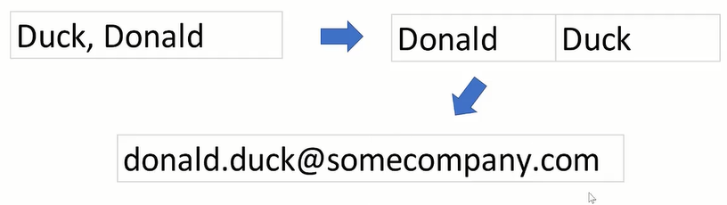
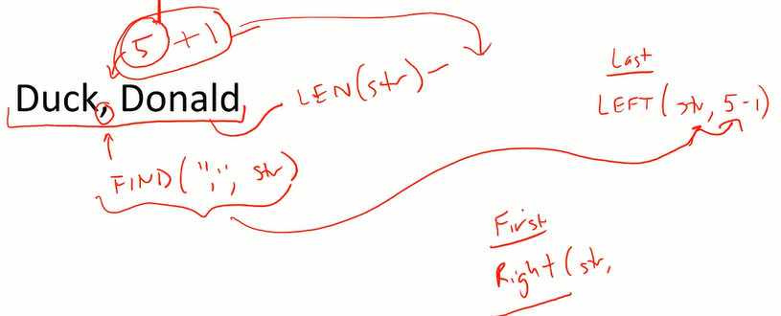
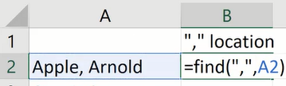





Create E-mail Addresses in Excel
Objective
Strategy
Step 2
Step 1
Step 3
Step 1
Find the comer position
Step 2
Use comer position to find last name
Step 3
Count from right(Total length(C2) subtract the length to comer and subtract 1 for space)
To make things simpler, can paste B2 and C2 into the formula for Last and First
Last:
First:
Now set up E-mail Addresses

Slide 13






Working with Strings in VBA
Sub Strings()
Dim s As String
s = "pneumonoultramicroscopicsilicovolcanoconiosis"
MsgBox Mid(s, 10, 10)
End Sub
MsgBox InStr(s, "micro")
MsgBox InStr(20, s, "no")
MsgBox UCase(s)
MsgBox LCase(s)
Option Base 1
Sub JoiningStrings()
Dim B(3) As String
B(1) = "A"
B(2) = "B"
B(3) = "C"
MsgBox Join(B)
End Sub
We notice the space between each letter, so we want to eliminate those spaces

Slide 14












Sub JoiningStringswithoutspace()
Dim B(3) As String, joinedmsg As String, msg As String, i As Integer
B(1) = "A"
B(2) = "B"
B(3) = "C"
joinedmsg = Join(B)
For i = 1 To Len(joinedmsg) Step 2 'step 2 means at 1, 3 and 5
msg = msg + Mid(joinedmsg, i, 1) ‘ join the letters to form msg
Next i
MsgBox msg
End Sub
Sub JoiningStringswithoutspace2()
Dim B(3) As String, joinedmsg As String, msg As String, i As Integer
B(1) = "AB"
B(2) = "CDE"
B(3) = "FG"
joinedmsg = Join(B)
For i = 1 To Len(joinedmsg) 'if we don't use step 2. We need IF NOT
If Not Mid(joinedmsg, i, 1) = “ ” Then ‘ If the letter is not space, then join together
msg = msg + Mid(joinedmsg, i, 1)
End If
Next i
MsgBox msg
End Sub
Examples of using strings in VBA
Sub SplitAndJoin()
Dim sentence As String, A() As String
sentence = InputBox("Please enter a sentence.")
A = Split(sentence, " ")
For i = 0 To UBound(A)
MsgBox A(i)
Next i
MsgBox Join(A)
End Sub
Sub CombineColumn()
Dim B As Object, msg As Variant, i As Integer, nr As Integer
Set B = Selection
nr = Selection.Rows.Count
For i = 1 To nr
msg = msg + B(i)
Next i
'Two different ways to output the strings
Range("F1") = msg
MsgBox msg
End Sub

Slide 15






Example: Extracting email addresses from mixed string formats

Slide 16

Following the approach outlined last page, we set up the VBA codes to extract the email addresses
Function Email(s As Range) As String
Dim L As Integer, i As Integer
Dim atLoc As Integer, EndLoc As Integer
L = Len(s)
atLoc = InStr(s, "@")
For i = atLoc - 1 To 1 Step -1
If Mid(s, i, 1) = ":" Or Mid(s, i, 1) = "<" Or Mid(s, i, 1) = " " Then
StartLoc = i + 1
Exit For 'once StartLoc is found we exit For Loop so we don't waste time
ElseIf i = 1 Then
StartLoc = 1
End If
Next i
For i = atLoc + 1 To L
If Mid(s, i, 1) = "]" Or Mid(s, i, 1) = ">" Then
EndLoc = i - 1
Exit For
ElseIf i = L Then
EndLoc = L
End If
Next i
Email = Mid(s, StartLoc, EndLoc - StartLoc + 1)
End Function

Slide 17










Example: VBA array function for separating strings into component parts
Do this in Excel
Do the same with VBA array function
Function Parts(s As String) As Variant
Dim L As Integer
Dim firstdash As Integer, seconddash As Integer
L = Len(s)
Dim P(3) As Variant
firstdash = InStr(1, s, "-")
seconddash = InStr(firstdash + 1, s, "-")
P(1) = Left(s, firstdash - 1)
P(2) = Mid(s, firstdash + 1, seconddash - firstdash - 1)
P(3) = Right(s, L - seconddash)
Parts = P
End Function

Slide 18



Exporting data from Excel to .txt files
'This Sub shows how to export data to .txt file format
Sub WriteFile()
Dim s As String, SaveFile As String
s = InputBox("Please enter text.")
'SaveFile is the file name user input into the save file window
SaveFile = Application.GetSaveAsFilename(filefilter:="Text Files (*.txt), *.txt")
'We open that file which at the moment is empty
Open SaveFile For Output As #1
'we write s to that empty file, then close the file
Write #1, s
Close #1
End Sub
'This Sub shows how to export data from a Selection in Excel to .txt file format
Sub WriteFile2()
Dim SaveFile As String, nr As Integer, i As Integer
nr = Selection.Rows.Count
'SaveFile is the file name user input into the save file window
SaveFile = Application.GetSaveAsFilename(filefilter:="Text Files (*.txt), *.txt")
'We open that file which at the moment is empty
Open SaveFile For Output As #1
'we write s to that empty file using a For Loop
For i = 1 To nr
Write #1, Selection.Cells(i, 1)
Next i
Close #1
End Sub

Slide 19



A(5) = {1,1,2,3,5}

Slide 20




Importing data from .txt files
'This Sub shows how to import .txt data already in coloumn format
Sub ImportText()
'FileName is the name of file the user navigate to
Dim FileName As String, s As String, nr As Integer, i As Integer
Dim tWB As Workbook, aWB As Workbook
Set tWB = ThisWorkbook
FileName = Application.GetSaveAsFilename(filefilter:="Text Files (*.txt), *.txt")
Workbooks.Open FileName
'The .txt data is first imported to an intermediate workbook called ActiveWorkbook
'and we extract data from this aWB into vector s(nr)
Set aWB = ActiveWorkbook
'This is another way to count no of rows in column A
nr = WorksheetFucntion.CountA(Columns("A:A"))
ReDim s(nr) As String
'Extract data from this aWB into vector s(nr)
For i = 1 To nr
s(i) = Range("A" & i)
Next i
'Close the intermediate workbook
aWB.Close SaveChanges:=False
'Turn the current workbook back to active workbook
tWB.Active
Range("A1:A" & nr) = WorksheetFunction.Transpose(s)
End Sub
aWB
tWB

Slide 21






Slide 22



Importing data from tab-delimited .txt files
There is a tab separating this data
'This Sub shows how to import Tab Delimited .txt dataSub ImportTextTabDelimited()
Sub ImportTextTabDelimited()
'FileName is the name of file the user navigate to
Dim FileName As String, s(6, 2) As Variant
Dim nr As Integer, nc As Integer, i As Integer, j As Integer
Dim tWB As Workbook, aWB As Workbook
Set tWB = ThisWorkbook
FileName = Application.GetSaveAsFilename(filefilter:="Text Files (*.txt), *.txt")
Workbooks.Open FileName
'The .txt data is first imported to an intermediate workbook called ActiveWorkbook
'and we extract data from this aWB into vector s(nr)
Set aWB = ActiveWorkbook
'From .txt. file we know the nr and nc
nr = 6
nc = 2
'Extract data from this aWB into vector s(nr)
For i = 1 To nr
For j = 1 To nc
s(i, 1) = Range("A" & i)
s(i, 2) = Range("B" & i)
Next j
Next i
'Close the intermediate workbook
aWB.Close SaveChanges:=False
'Turn the current workbook back to active workbook
tWB.Active
Range("A1:B6") = s
End Sub

Slide 23


Translate Letters into Morse Code and save in .txt file
Option Explicit
Option Base 1
Sub MorseCoder()
Dim L As Integer, i As Integer, j As Integer, wrd As String
Dim Letters() As String, coded() As String, SaveFile As String
wrd = UCase(Range("E7"))
L = Len(wrd)
ReDim Letters(L) As String
ReDim coded(L) As String
For i = 1 To L
Letters(i) = Mid(wrd, i, 1) 'Assign letters in wrd to vector L
For j = 1 To 36 'now we match the letters with morse code
If Letters(i) = Range("A1:A36").Cells(j, 1).Text Then
coded(i) = Range("B1:B36").Cells(j, 1).Text
Exit For 'Once match is found, we can exit For Loop
End If
Next j
'at the same time, place element of coded next to E7
Range("E7").Offset(i - 1, 1) = coded(i)
Next i
'Now we save the morese code into a .txt file
SaveFile = Application.GetSaveAsFilename(filefilter:="Text Files (*.txt), *.txt")
Open SaveFile For Output As #1
For i = 1 To L
Write #1, coded(i)
Next i
Close #1
End Sub
‘Put a reset button to clear Morse code in column F
Sub Reset()
Columns("F:F").Clear
End Sub

Slide 24



Translate Morse Code into Letters
Option Base 1
Sub MorseDecoder()
Dim FileName As String, aWB As Workbook, tWB As Workbook
Dim nr As Integer, i As Integer, j As Integer
Dim coded() As String, Letters() As String, word As String
FileName = Application.GetOpenFilename(filefilter:="Text Files (*.txt), *.txt")
Workbooks.Open FileName
'Now the txt file has been imported as an excel file
Set aWB = ActiveWorkbook
Range("A1").Select
nr = WorksheetFunction.CountA(Columns("A:A"))
ReDim coded(nr) As String, Letters(nr) As String
For i = 1 To nr
coded(i) = Range("A1:A" & nr).Cells(i, 1)
Next i
'Now we have successfully transferred the Morse code from aWB's column A
'into the coded vector, so we need to close the ActiveWOrkbook
aWB.Close SaveChanges:=False
'Now we need to convert each element of coded vector back into letters
For i = 1 To nr
For j = 1 To 36
If coded(i) = Range("B1:B36").Cells(j, 1).Text Then
Letters(i) = Range("A1:A36").Cells(j, 1).Text
Exit For
End If
Next j
word = word + Letters(i)
Next i
'Now we have decoded the Morse code into the Letters vector, and merged the letters
'into a single word in word
MsgBox word
End Sub

Slide 25


Working with Worksheets
Option Explicit
Sub WorksheetTests()
MsgBox Worksheets.Count
MsgBox Worksheets(2).Name
MsgBox ActiveSheet.Name
End Sub
Sub WorksheetTests1()
Dim sheetname As String
sheetname = ActiveSheet.Name
End Sub
Sub WorksheetAdd()
Sheets.Add After:=ActiveSheet
End Sub
Sub WorksheetDelete()
Application.DisplayAlerts=False
Sheets(“Sheet2”).Delete
End Sub
Sub WorksheetRename()
Sheets(“Sheet3”).Name = “Data”
End Sub
Sheets refer to all the sheets, including charts. So, charts can take up tabs or sheets in your workbook.
If you just want to refer to worksheets then you can use worksheets. So, if I want to count only the worksheets without the charts then I'd use Worksheets.Count.
Sub WorksheetTest2()
MsgBox Sheets(“Sheet4”).Range(“A1”)
End Sub
Sub WorksheetTest3()
Sheets("Sheet6").Activate
Range("C5").Select
Selection.Copy
Sheets("Sheet4").Activate
Range("A3").PasteSpecial
End Sub
Sub WorksheetTest3_ShortVersion()
Sheets("Sheet4").Range("A3") = Sheets("Sheet6").Range("C5")
End Sub
Sub WorksheetHide()
Sheets("Sheet4").Visible = False
Sheets("Sheet4").Visisble = True
End Sub

Slide 26



Iterating through worksheets
In this example we iterate through our worksheets and do something to them.
For Each Loop to add 7 in B2 for all sheets
For Next Loop to add 7 in B2 for all sheets
Sub PlaceSeven()
Dim w As Worksheet 'w is our object in the For Each statement
For Each w In Worksheets
w.Range("B2") = 7
Next
End Sub
Sub PlaceSeven2()
Dim i As Integer, n As Integer
n = Worksheets.Count
For i = 1 To n
Worksheets(i).Range("B2") = 4
Next i
End Sub
'Place 10 in B4 in sheets named Data1, Data2, Data3
Sub Place7inDataSheets()
Dim i As Integer, n As Integer
n = Worksheets.Count
For i = 1 To n
If Left(Worksheet(i).Name, 1) = "D" Then
Worksheet(i).Range("B4") = 10
End If
Next i
End Sub
'This Sub asks for user's name, then ask how many sheets the user wants to create
'then allows the user to rename each sheet, then adds user's name into cell A1 of each sheet
Sub AddandNameSheets()
Dim i As Integer, n As Integer, PersonName As String, SheetName As String
PersonName = InputBox("What is your name?")
n = InputBox("How many sheets do you want in your workbook?")
'Because there is alreay one sheet at the begining, we need n-1
For i = 1 To (n - 1)
Sheets.Add After:=ActiveSheet
Next i
'Ask user to input each sheetname
For i = 1 To n
SheetName = InputBox("What is the name of sheet" & i & "?")
Worksheet(i).Name = SheetName
Worksheet(i).Range("A1") = PersonName
Next i
End Sub

Slide 27
Consolidating information in multiple worksheets into a single worksheet
'Extract cell A1 from worksheets2 to 6 and place them in a vector
'in workSheet1 at cell A1. Also join words into a single string and
'place into A2
Options Base 1
Sub Consolidate()
Dim A() As String
Dim i As Integer, n As Integer
n = Worksheets.Count
ReDim A(n - 1) As Variant
'Extract cells A1 and put into vector A
For i = 2 To n
A(i - 1) = Worksheet(i).Range("A1")
Next i
Worksheet(1).Range("A1:A" & n - 1) = WorksheetFunction.Transpose(A)
Worksheet(1).Range("A2") = Join(A, " ")
End Sub

Slide 28


Counting total number of 7's in all worksheets of a workbook
Objective: Iterate through the worksheets and count the number of 7s that are in the workbook.
And then, we're going to take that result and either display it in the message box or maybe write it to sheet1.Remember worksheet1 is empty so nothing to extract from there.
2
This loop is to Iterate through the Worksheets
This loop is to Iterate through the rows and columns of the arrays
'This Sub counts the number of 7s in worksheets 2 to 6 and
'outputs the number in MsgBox and CellA1 of sheet1
Sub CountSeven()
Dim i As Integer, j As Integer, k As Integer
Dim nr As Integer, nc As Integer, nw As Integer, c As Integer
nr = 6
nc = 4
nw = Worksheets.Count
For i = 2 To nw
For j = 1 To nr
For k = 1 To nc
If Range("C5:F10").Cells(j, k) = 7 Then
c = c + 1
End If
Next k
Next j
Next i
MsgBox "Total no of 7s = " & c
Worksheet(1).Range("A1") = "Total no of 7s = " & c
End Sub

Slide 29




Putting it all together: Consolidating employee schedules in multiple worksheets
Objective: There are 6 different employees. Each employee submits their weekly availability for a joint meeting time. So we have the following sheets: Summary, Jim, Suzy, Charlie, Emily, Jennifer, Rex. We want to consolidate schedules by iterating through all sheets to count the time slots marked by X's and sum up the times in the Summary worksheet. Then we identify time slots with maximum availabilities and highlight the slot in green. So the user can just say, Tuesday from 1 to 2 is a great time to meet, or Friday from 11 to 12 is a great time. See the diagrams below:
This loop is to Iterate through the Worksheets
Increase the counts in this S array for the Summary Worksheet as we count the Xs in each employee worksheet

Slide 30
Option Base 1
Sub ConsolidateSchedules()
Dim w As Worksheet, i As Integer, j As Integer, nr As Integer, nc As Integer, max As Integer
Dim S() As Variant, c As Range
nr = 9
nc = 5
ReDim S(nr, nc) As Variant
'We want to exclude Summary worksheet in the loop, so need to add If Not Loop
For Each w In Worksheets
If Not w.Name = "Summary" Then
For i = 1 To nr
For j = 1 To nc
If w.Range("B4:F12").Cells(i, j) = "X" Then
S(i, j) = S(i, j) + 1
End If
Next j
Next i
End If
Next
'Now we have formed our Summary Schedule Array
Worksheets("Summary").Range("B4:F12") = S
'Now we identify the maximum availabilities in this Summary array and highlight in green
max = WorksheetFunction.max(S)
For Each c In Worksheets("Summary").Range("B4:F12")
If c.Value = max Then
With c.Interior
.Pattern = xlSolid
.PatternColorIndex = xlAutomatic
.Color = 5296274
.TintAndShade = 0
.PatternTintAndShade = 0
End With
Else
With c.Interior
.Pattern = xlNone
.TintAndShade = 0
.PatternTintAndShade = 0
End With
End If
Next
End Sub
Sub Reset()
Dim c As Range
For Each c In Worksheets("Summary").Range("B4:F12")
c.Clear
With c.Interior
.Pattern = xlNone
.TintAndShade = 0
.PatternTintAndShade = 0
End With
Next
End Sub

Slide 31


All about workbooks
'This Sub finds information about workbooks opened
Sub WorkbookTest()
MsgBox Workbooks.Count
MsgBox Workbooks(2).Name
MsgBox ActiveWorkbook.Name
Workbooks(5).Close SaveChanges:=False 'or True
Workbooks("File_2.xlsx").Close SaveChanges:=True
Workbooks.Add 'Creates new workbook
Workbooks(2).Name = "FileNmae" 'Renames a workbood
ActiveWorkbook.SaveAs FileName:="D:\Coursera 2018 Excel VBA SQL Courses\...\Test.xlsm", FileFormat:=xlOpenXMLWorkbookMacroEnabled, CreaateBackup:=False
Workbooks("File_1.xlsm").Activate 'Moving back and forth between workbooks
MsgBox Workbooks(3).Worksheets("Sheet1").Range("A1")
End Sub
Sub WorkbooksTest2()
Dim tWB As Workbook, aWB As Workbook
Set tWB = ThisWorkbook
Workbooks("File_3.xlsm").Activate
Set aWB = ActiveWorkbook 'aWB is assigned to File_3.xlsm
MsgBox tWB.Sheets("Sheet1").Range("A1")
Workbooks("File_5.xlsm").Activate
MsgBox aWB.Sheets("Sheet1").Range("A1") 'this refers to File_3.xlsm because aWB was assigned earlier
End Sub
'This is how to close all workbooks except the current one
Sub WorkbookTest3()
Dim w As Workbook
For Each w In Workbooks
If Not w.IsThisWorkbook Then
w.Close
End If
Next
End Sub

Slide 32


Opening workbooks
'Open a single static workbook. Static means file path is known
Sub OpenStaticFile()
Dim FileName As String
FileName = "D:\Coursera 2018 Excel VBA SQL Courses\...\Test.xlsm"
Workbooks.Open FileName
End Sub
Option Base 1
'Open multiple static workbooks
Sub OpenStaticFile()
'FileName is now a vector with 2 string elements
Dim FileNames(2) As String, i As Integer
FileNames(1) = "D:\Coursera 2018 Excel VBA SQL Courses\...\Test1.xlsm"
FileNames(2) = "D:\Coursera 2018 Excel VBA SQL Courses\...\Test2.xlsm"
For i = 1 To UBound(FileNames)
Workbooks.Open FileNames(i)
Next i
End Sub
'Allows user to select a workbook file from an Open File Application Box
Sub OpenUserFile()
Dim FileName As String
FileName = Application.GetOpenFilename(FileFilter:="Excel Filter (*.xlsm), *.xlsm", Title:="Open File(s)", MultiSelect:=False)
Workbooks.Open FileName
End Sub
'Allows user to select multiple workbook file from an Open File Application Box
Sub OpenUserFile()
Dim FileNames As Variant, i As Integer
FileName = Application.GetOpenFilename(FileFilter:="Excel Filter (*.xlsm), *.xlsm", Title:="Open File(s)", MultiSelect:=True)
For i = 1 To UBound(FileNames)
Workbooks.Open FileNames(i)
Next i
End Sub

Slide 33

'Allows user to open all files inside a folder
Sub OpenAllinFolder()
Dim Folder As String, FileName As String
Folder = "D:\Coursera 2018 Excel VBA SQL Courses\...\Test1.xlsm"
FileName = Dir(Folder & "\*.xlsx")
Do
Workbooks.Open Folder & "\" & FileName
FileName = Dir
Loop Until FileName = ""
End Sub
'Only open files named Data
Sub OpenCertainFilenames()
Dim Folder As String, FileName As String
Folder = "D:\Coursera 2018 Excel VBA SQL Courses\...\Test1.xlsm"
FileName = Dir(Folder & "\*.xlsx")
Do
If Left(FileName, 1) = "D" Then
Workbooks.Open Folder & "\" & FileName
End If
FileName = Dir
Loop Until FileName = ""
End Sub

Slide 34


Example: Importing and consolidating data from multiple files
Objective: ‘Open workbooks of user’s choice in a folder, then import data from Sheet1 Cell A1 in those workbooks
‘into This Workbook Sheet1 Cells A3 downwards
'Open workbooks of user's choice, then import data from Sheet1 Cell A1 in those workbooks
'into This Workbook
Sub ImportData()
Dim FileNames() As Variant, nw As Integer, A() As String, i As Integer
Dim aWB As Workbook, tWB As Workbook
Set tWB = ThisWorkbook
FileNames = Application.GetOpenFilename(FileFilter:=“Excel Filter (*.xlsx), *.xlsx”, Title:=“Open File(s)”, _
MultiSelect:=True)
Application.ScreenUpdating=False
nw = UBound(FileNames)
ReDim A(nw) As String
For i = 1 To nw
Workbooks.Open FileNames(i)
Set aWB = ActiveWorkbook
A(i) = aWB.Sheets("Sheet1").Range("A1")
aWB.Close SaveChanges:=False
Next i
tWB.Activate
tWB.Sheets("Sheet1").Range("A3:A" & nw + 2) = WorksheetFunction.Transpose(A)
End Sub

Slide 35
Counting 7's in multiple workbooks
'Opens workbooks of users' choice and look for 7s in sheet1, and outputs the total count in MsgBox
Sub CountSevens2()
Dim FileNames() As Variant, nw As Integer, A() As String
Dim i As Integer, j As Integer, k As Integer, c As Integer
Dim aWB As Workbook, tWB As Workbook
Set tWB = ThisWorkbook
FileNames = Application.GetOpenFilename(FileFilter:="Excel Filter (*.xlsx), *.xlsx", Title:="Open File(s)", MultiSelect:=True)
Application.ScreenUpdating = False
nw = UBound(FileNames)
For i = 1 To nw
Workbooks.Open FileNames(i)
Set aWB = ActiveWorkbook
For j = 1 To 6
For k = 1 To 4
If aWB.Sheets("Sheet1").Range("C5:F10").Cells(j, k) = 7 Then
c = c + 1
End If
Next k
Next j
aWB.Close SaveChanges:=False
Next i
MsgBox c
End Sub

Slide 36


Consolidating employee schedules From Different Workbooks
'Consolidates all employee workbooks in a Folder and find the maximum availability for meetings
Sub ConsolidateSchedules2()
Dim w As Worksheet, i As Integer, j As Integer, Folder As String, FileName As String
Dim nr As Integer, nc As Integer, max As Integer, S() As Variant, c As Range
Dim aWB As Workbook, tWB As Workbook
Set tWB = ThisWorkbook
nr = 9
nc = 5
ReDim S(nr, nc) As Variant
'We will loop through all the xlsx files inside a static folder
Folder = “D:\Coursera 2018 Excel VBA SQL Courses\Coursera Excel VBA Course\ExcelVBA for Creative Problem _ Solving - Part 2\Week 3 STARTER files\Employee Schedules"
FileName = Dir(Folder & "\*.xlsx")
Do
Workbooks.Open Folder & "\" & FileName
Set aWB = ActiveWorkbook
For Each w In Worksheets
For i = 1 To nr
For j = 1 To nc
If w.Range("B4:F12").Cells(i, j) = "X" Then
S(i, j) = S(i, j) + 1
End If
Next j
Next i
Next
aWB.Close SaveChanges:=False
FileName = Dir
Loop Until FileName = ""
tWB.Activate
'Now we put the availability array S into Summary worksheet
Worksheets("Summary").Range("B4:F12") = S
'Now we identify the maximum availabilities in this Summary array and highlight in green
max = WorksheetFunction.max(S)
For Each c In Worksheets("Summary").Range("B4:F12")
If c.Value = max Then
With c.Interior
.Pattern = xlSolid
.PatternColorIndex = xlAutomatic
.Color = 5296274
.TintAndShade = 0
.PatternTintAndShade = 0
End With
Else 'Resetting the cell to normal colour
With c.Interior
.Pattern = xlNone
.TintAndShade = 0
.PatternTintAndShade = 0
End With
End If
Next
End Sub
'Creates the Reset Button
Sub Reset()
Dim c As Range
For Each c In Worksheets("Summary").Range("B4:F12")
c.Clear
With c.Interior
.Pattern = xlNone
.TintAndShade = 0
.PatternTintAndShade = 0
End With
Next
End Sub

Slide 37


Further Examples

Slide 38




Advanced input boxes
Sub InputBoxTest()
Dim x As Variant
Do
x = InputBox("Please enter something")
If x <> "" Then Exit Do
MsgBox ("You didn't enter anything, Please try again!")
Loop
MsgBox ("You entered " & x)
End Sub
Advanced message boxes

Slide 39









Sub MsgBoxExample()
Dim Ans As Integer
Ans = MsgBox("Hello", vbOKCancel, "Output")
End Sub
Sub MsgBoxExample1()
Dim Ans As Integer
Ans = MsgBox("Hello", 2, "Title")
End Sub
Sub MsgBoxExample2()
Dim Ans As Integer
Ans = MsgBox("Hello", 32, "Question Box")
End Sub
If I click OK button, Ans will return a value of 1
Sub MsgBoxExample3()
Dim Ans As Integer
Ans = MsgBox("Hello", 36, "Question Box")
End Sub

Slide 40











Event handlers

Slide 41




Slide 42



Introduction to user forms
They are really nice ways to interface professionally with a user, like a client or a coworker.
You can interface with the web. So here, I've got a user form that pulls data off the Noah website. I could click on that to get current temperature in Denali National Park is 30 degrees.

Slide 43



Creating your first user form
Drag and drop the Tools into the form
The Properties window shows object properties. Can rename object names (no space allowed in names)

Slide 44





Set up a frame, then put OptionButtons inside
To make a button selected by default, change the Value to True in Properties Windows

Slide 45



Private Sub QuitButton_Click()
UserForm1.Hide
'Unload UserForm1
End Sub
To put codes for a button, double click the button
Private Sub CalculateButton_Click()
If multipy Then
Output = AInput * BInput
Else
Output = AInput / BInput
End If
End Sub
Private Sub QuitButton_Click()
UserForm1.Hide
'Unload UserForm1
End Sub
Private Sub ResetButton_Click()
Unload UserForm1
UserForm1.Show
End Sub
Now we have set up the codes for all the buttons

Slide 46


Set up a Sub called RunForm to launch the Form
Then set up an Event Handler so the RunForm Sub is automatically run when the Workbook is opened

Slide 47




Example: Fuel efficiency user form
Object names
Dist
Vol
Mpg
Kpl
Mile / km
Gal / liters
GoButton
QuitButton
The GO button has 4 ways to calculate, so we need to include them in the nested If Else statements”
Miles -> Gal
Miles -> Liters
Km -> Gal
Km -> Liters
Private Sub GoButton_Click()
If miles Then
If gal Then
mpg = FormatNumber(dist / vol, 1)
kpl = FormatNumber(dist / 0.62 / vol / 3.78, 1)
Else
mpg = FormatNumber(dist / vol * 3.78, 1)
kpl = FormatNumber(dist / 0.62 / vol, 1)
End If
Else
If gal Then
mpg = FormatNumber(dist * 0.62 / vol, 1)
kpl = FormatNumber(dist / (vol * 3.78), 1)
Else
mpg = FormatNumber(dist * 0.62 / vol * 3.78, 1)
kpl = FormatNumber(dist / vol, 1)
End If
End If
End Sub
Private Sub QuitButton_Click()
Unload FuelCalculator
End Sub

Slide 48




Slide 49



Example: Tank volume user form
Object names
Ht
Radius
Rho
Depth
mass
Private Sub CalculateButton_Click()
Dim pi As Double, V As Double
pi = WorksheetFunction.pi()
If depth <= Radius Then
V = pi * depth ^ 2 / 3 * (3 * Radius - depth)
ElseIf depth <= Ht - Radius Then
V = 2 / 3 * pi * Radius ^ 3 + pi * Radius ^ 2 * (depth - Radius)
Else
V = 4 / 3 * pi * Radius ^ 3 + pi * Radius ^ 2 * (Ht - 2 * Radius) _
- pi * (Ht - depth) ^ 2 / 3 * (3 * Radius - Ht + depth)
End If
mass = FormatNumber(rho * V, 0)
End Sub
Private Sub QuitButton_Click()
Unload TankForm
End Sub

Slide 50

Dim'ming (or not Dim'ming) variables in user forms
Anything that goes into one of these text boxes that you put on the user form,
or any of the variables that you use. For example, these bullion radio buttons, you don't have to dim those variables.

Slide 51


Input validation in user forms
All these input validation is going to go at the very beginning of the sub,
Private Sub CalculateButton_Click()
Dim pi As Double, V As Double
pi = WorksheetFunction.pi()
If Ht < 0 Or Radius < 0 Or rho < 0 Or depth < 0 Then
MsgBox ("At least one of the inputs is negative! Pleaes try again.")
Exit Sub
End If
If Not IsNumeric(Ht) Or Not IsNumeric(Radius) Or Not IsNumeric(rho) Or Not IsNumeric(depth) Then
MsgBox ("At least one of the inputs is not a number! Pleaes try again.")
Exit Sub
End If
If Ht = "" Or Radius = "" Or rho = "" Or depth = "" Then
MsgBox ("At least one of the inputs is missing! Pleaes try again.")
Exit Sub
End If
If depth > Ht Then
MsgBox ("Fluid depth cannot exceed the height of the tank! Please try again.")
Exit Sub
End If
If depth <= Radius Then
V = pi * depth ^ 2 / 3 * (3 * Radius - depth)
ElseIf depth <= Ht - Radius Then
V = 2 / 3 * pi * Radius ^ 3 + pi * Radius ^ 2 * (depth - Radius)
Else
V = 4 / 3 * pi * Radius ^ 3 + pi * Radius ^ 2 * (Ht - 2 * Radius) _
- pi * (Ht - depth) ^ 2 / 3 * (3 * Radius - Ht + depth)
End If
mass = FormatNumber(rho * V, 0)
End Sub
Private Sub QuitButton_Click()
Unload TankForm
End Sub
This section of code handles input validation so it returns an MsgBox to warn the user if incorrect types of inputs were used.

Slide 52





Introduction to combo boxes, Part 1
Objective:
Put the names inside a combo box and show the corresponding
letter
Method:
Create a form and combo box
Option Explicit
Option Base 1
Sub PopulateComboBox1()
Dim Names() As String, n As Integer, i As Integer
n = WorksheetFunction.CountA(Columns("A:A"))
ReDim Names(n) As String
For i = 1 To n
Names(i) = Range("A1:A" & n).Cells(i, 1)
UserForm1.ComboBox1.AddItem Names(i)
Next i
End Sub
Sub RunForm1()
Call PopulateComboBox1
UserForm1.Show
End Sub
Use a Module and create a Sub to put the selections into a combo box
Assign this sub to an Event Handler so the form is loaded when the workbook opens
Private Sub GoButton_Click()
Range("A1").Select
MsgBox ActiveCell.Offset(ComboBox1.ListIndex, 1)
End Sub
Private Sub QuitButton_Click()
Unload UserForm1
End Sub
Private Sub RemoveButton_Click()
Dim RemoveIndex As Integer
RemoveIndex = UserForm1.ComboBox1.ListIndex
UserForm1.ComboBox1.RemoveItem RemoveIndex
'Modeify the delete row action from Macro recording
Rows(RemoveIndex + 1 & ":" & RemoveIndex + 1).Select
Selection.Delete Shift:=xlUp
End Sub

Slide 53





Example: Periodic table user form
The objective is to allow user to select chemical elements and the Form will automatically show the information regarding the chosen element. Then the Form will automatically update when the user selects a different element without having to press the GO button again
First we set up Subs to populate the comboBox and a Sub to Run the form
Private Sub ComboBox1_Change()
Dim index As Integer
'Remember that the ListIndex starts at 0 not 1
index = UserForm1.ComboBox1.ListIndex
'Now we use Index to place the data into the text boxes
symbol = Range("A2:D" & n).Cells(index + 1, 2)
atomicnumber = Range("A2:D" & n).Cells(index + 1, 3)
atomicmass = Range("A2:D" & n).Cells(index + 1, 4)
End Sub
Private Sub GoButton_Click()
Dim index As Integer
'Remember that the ListIndex starts at 0 not 1
index = UserForm1.ComboBox1.ListIndex
'Now we use Index to place the data into the text boxes
symbol = Range("A2:D" & n).Cells(index + 1, 2)
atomicnumber = Range("A2:D" & n).Cells(index + 1, 3)
atomicmass = Range("A2:D" & n).Cells(index + 1, 4)
End Sub
Private Sub QuitButton_Click()
Unload UserForm1
End Sub
Copy the code into the ComboBox1_Change() Sub so that when the user selects another chemical element there is no need to press the GO button again

Slide 54


Putting it all together: Conversion Solver user form
Object names
Pressure
TempSelect
Conversion
Option Explicit
Sub PopulateComboBox()
ConversionForm.TempSelect.AddItem "300"
ConversionForm.TempSelect.AddItem "400"
ConversionForm.TempSelect.AddItem "450"
ConversionForm.TempSelect.AddItem "500"
ConversionForm.TempSelect.AddItem "550"
ConversionForm.TempSelect.AddItem "600"
ConversionForm.TempSelect.Text = "300"
End Sub
Sub OpenUserForm()
PopulateComboBox
ConversionForm.Show
End Sub
Set up Sub to populate comboBox and launch the form

Slide 55

Private Sub CalculateButton_Click()
Dim low As Double, mid As Double, high As Double, Ke As Double, i As Integer
Dim flow As Double, fmid As Double, fhigh As Double, idx As Integer
'Deal with input validation
If Pressure = "" Then
MsgBox "Pressure cannot be empty!"
Exit Sub
End If
If Not IsNumeric(Pressure) Then
MsgBox "Pressure has to be a number!"
Exit Sub
End If
If Pressure < 0.001 Or Pressure > 1000 Then
MsgBox "Pressure must be between 0.001 and 1000 bar!"
Exit Sub
End If
'Find the correspoding Ke based on Temperature
idx = ConversionForm.TempSelect.ListIndex
If idx = 0 Then 'case when T = 300C
Ke = 0.0043
ElseIf idx = 0 Then 'case when T = 400C
Ke = 0.000164
ElseIf idx = 0 Then 'case when T = 450C
Ke = 0.0000451
ElseIf idx = 0 Then 'case when T = 500C
Ke = 0.0000145
ElseIf idx = 0 Then 'case when T = 500C
Ke = 0.00000538
ElseIf idx = 0 Then 'case when T = 600C
Ke = 0.00000225
End If
'Now find the converstion X using bisection method
low = 0
high = 0.999
For i = 1 To 20
mid = (low + high) / 2
flow = func(Pressure, Ke, low)
fmid = func(Pressure, Ke, mid)
fhigh = func(Pressure, Ke, high)
If flow * fmid < 0 Then
high = mid
Else
low = mid
End If
Next i
'we times by 100 to change decimals to percentages
Conversion = FormatNumber(100 * (high + low) / 2, 1)
End Sub
Function func(P, Ke, x)
func = 16 * x ^ 2 * (2 - x) ^ 2 / 27 / (1 - x) ^ 4 / P ^ 2 - Ke
End Function
Private Sub QuitButton_Click()
Unload ConversionForm
End Sub
Private Sub ResetButton_Click()
Unload ConversionForm
OpenUserForm
End Sub

